Slide 1
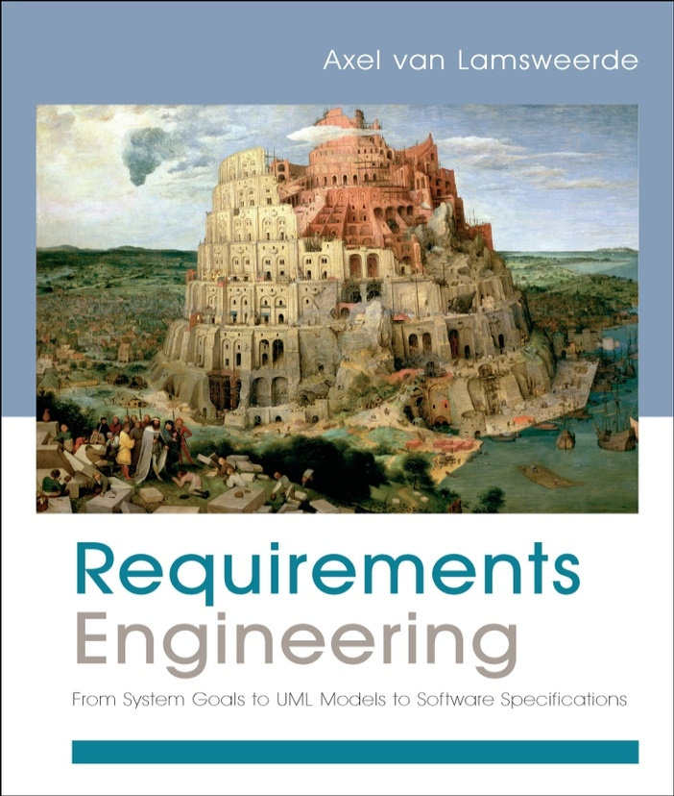
Requirements Engineering
From System Goals to UML Models to Software Specifications
Axel Van Lamsweerde

Slide 2

Fundamentals of RE
Chapter 2
Domain Understanding
& Requirements Elicitation

Slide 3


Chap.1: RE products and processes
alternative options
Chap. 2:
Elicitation
Techniques
consolidated
start
agreed
requirements
requirements
documented requirements

Slide 4

A great deal of knowledge acquisition is involved: as introduced in Chapter 1 ...
Studying the system-as-is
  Business organization: structure, dependencies, strategic objectives, policies, workflows, operational procedures, ...
  Application domain: concepts, objectives, tasks, constraints, regulations, ...
  Analysis of problems with system-as-is: symptoms, causes, consequences
Analyzing technology opportunities, new market conditions
Identifying the system stakeholders
Identifying improvement objectives; organizational & technical constraints on system-to-be; alternative options for satisfying objectives, for assigning responsibilities; scenarios of hypothetical software-environment interaction; requirements on software, assumptions on environment

Slide 5
Domain analysis & requirements elicitation: outline
Identifying stakeholders & interacting with them
Artefact-driven elicitation techniques
  Background study
  Data collection, questionnaires
  Repertory grids, card sorts for concept acquisition
  Scenarios, storyboards for problem world exploration
  Prototypes, mock-ups for early feedback
  Knowledge reuse: domain-independent, domain-specific
Stakeholder-driven elicitation techniques
  Interviews
  Observation and ethnographic studies
  Group sessions

Slide 6

Stakeholder analysis
Stakeholder cooperation is essential for successful RE
  Elicitation = cooperative learning
Representative sample must be selected to ensure adequate, comprehensive coverage of the problem world
  dynamic selection as new knowledge is acquired
Selection based on ...
  relevant position in the organization
  role in making decisions, reaching agreement
  type of contributed knowledge, level of domain expertise
  exposure to perceived problems
  personal interests, potential conflicts
  influence in system acceptance

Slide 7

Knowledge acquisition from stakeholders is difficult
Distributed sources, conflicting viewpoints
Difficult access to key people & data
Different background, terminology, culture
Tacit knowledge, hidden needs
Irrelevant details
Internal politics, competition, resistance to change, ...
Personnel turnover, changes in organization, in priorities, ...
⇒ Needed:
  Communication skills: for talking to, listening from diverse people
  Trust relationship
  Knowledge reformulation & restructuring (review meetings)

Slide 8

Background study
Collect, read, synthesize documents about...
  the organization: organizational charts, business plans, financial reports, meeting minutes, etc
  the domain: books, surveys, articles, regulations, reports on similar systems in the same domain
  the system-as-is: documented workflows, procedures, business rules; exchanged documents; defect/complaint reports, change requests, etc.
Provides basics for getting prepared before meeting stakeholders => prerequisite to other techniques
Data mining problem: huge documentation, irrelevant details, outdated info
Solution: use meta-knowledge to prune the doc space
  know what you need to know & what you don’t need to know

Slide 9

Data collection
Gather undocumented facts & figures
  marketing data, usage statistics, performance figures, costs, ...
  by designed experiments or selection of representative data sets from available sources (use of statistical sampling techniques)
May complement background study
Helpful for eliciting non-functional reqs on performance, usability, cost etc.
Difficulties:
  Getting reliable data may take time
  Data must be correctly interpreted

Slide 10

Questionnaires
Submit a list of questions to selected stakeholders, each with a list of possible answers (+ brief context if needed)
  Multiple choice question: one answer to be selected from answer list
  Weighting question: list of statements to be weighted...
    qualitatively (‘high’, ‘low”, ...), or
    quantitatively (percentages)
    to express perceived importance, preference, risk etc.
Effective for acquiring subjective info quickly, cheaply, remotely from many people
Helpful for preparing better focussed interviews (see next)

Slide 11
Questionnaires should be carefully prepared
Subject to ...
  multiple biases: recipients, respondents, questions, answers
  unreliable info: misinterpretation of questions, of answers, inconsistent answers, ....
=> Guidelines for questionnaire design/validation:
  Select a representative, statistically significant sample of people; provide motivation for responding
  Check coverage of questions, of possible answers
  Make sure questions, answers, formulations are unbiased & unambiguous
  Add implicitly redundant questions to detect inconsistent answers
  Have your questionnaire checked by a third party

Slide 12
Card sorts & repertory grids
♣ ♦
♥ ♠
Goal: acquire further info about concepts already elicited
Card sort: ask stakeholders to partition a set of cards ...
  Each card captures a concept textually or graphically
  Cards grouped into subsets based on stakeholder’s criteria
  For each subset, ask...
    ? implicit shared property used for grouping ?
    ? descriptive, prescriptive ?
  Iterate with same cards for new groupings/properties
Example: meeting scheduling system
  Iteration 1: “Meeting”, “Participant” grouped together
  => “participants shall be invited to the meeting”
  Iteration 2: “Meeting”, “Participant” grouped together
  => “participant constraints for the meeting must be known”

Slide 13
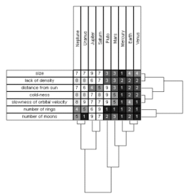
Card sorts & repertory grids (2)
Repertory grid: ask stakeholders to characterize target concept through attributes and value ranges
  => concept-attribute grid
  e.g. (Date, Mon-Fri), (Location, Europe)
  for grid characterizing Meeting concept
Conceptual laddering: ask stakeholders to classify target concepts along class-subclass links
  e.g. subclasses RegularMeeting, OccasionalMeeting of Meeting
☺ Simple, cheap, easy-to-use techniques for prompt elicitation of missing info
☹ Results may be subjective, irrelevant, inaccurate

Slide 14

Scenarios & storyboards
Goal: acquire or validate info from concrete examples through narratives ...
  how things are running in the system-as-is
  how things should be running in the system-to-be
Storyboard: tells a story by a sequence of snapshots
  Snapshot = sentence, sketch, slide, picture, etc.
  Possibly structured with annotations:
    WHO are the players, WHAT happens to them, WHY this happens, WHAT IF this does / does not happen, etc
  Passive mode (for validation): stakeholders are told the story
  Active mode (for joint exploration): stakeholders contribute

Slide 15
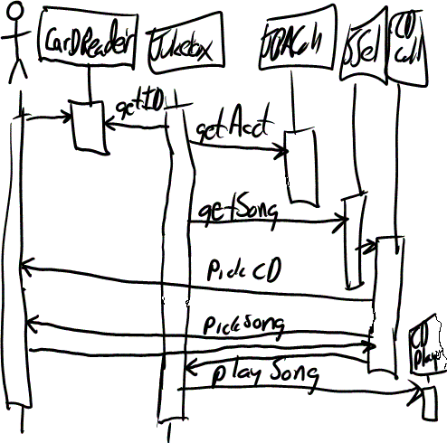
Scenarios
Illustrate typical sequences of interaction among system components to meet an implicit objective
Widely used for...
  explanation of system-as-is
  exploration of system-to-be + elicitation of further info ...
  e.g. WHY this interaction sequence ?
  WHY among these components ?
  specification of acceptance test cases
Represented by text or diagram (see Chap. 4)

Slide 16

Scenario example: meeting scheduling
1. The initiator asks the scheduler for planning a meeting within some date range. The request includes a list of desired participants.
2. The scheduler checks that the initiator is entitled to do so and that the request is valid. It confirms to the initiator that the requested meeting is initiated.
3. The scheduler asks all participants in the submitted list to send their date and location constraints back within the prescribed date range.
4. When a participant returns her constraints, the scheduler validates them (e.g., with respect to the prescribed date range). It confirms to the participant that the constraints have been safely received.
5. Once all valid constraints are received, the scheduler determines a meeting date and location that fit them.
6. The scheduler notifies the scheduled meeting date and location to the initiator and to all invited participants

Slide 17
Types of scenario
Positive scenario = one behavior the system should cover (example)
Negative scenario = one behavior the system should exclude (counter-example), e.g.
  1. A participant returns a list of constraints covering all dates within the given date range
  2. The scheduler forwards this message to all participants asking them for alternative constraints within extended date range
Normal scenario: everything proceeds as expected
Abnormal scenario = a desired interaction sequence in exception situation (still positive)
  e.g. meeting initiator not authorized
  participant constraints not valid

Slide 18
Scenarios: pros & cons
☺ Concrete examples/counter-examples
☺ Narrative style (appealing to stakeholders)
☺ Yield animation sequences, acceptance test cases
☹ Inherently partial (cf. test coverage problem)
☹ Combinatorial explosion (cf. program traces)
☹ Potential overspecification: unnecessary sequencing,
premature software-environment boundary
☹ May contain irrelevant details,
incompatible granularities from different stakeholders
☹ Keep requirements implicit
cf. confidentiality req in negative scenario example
Concrete scenarios naturally jump in anyway...
invaluable as initial elicitation vehicles

Slide 19

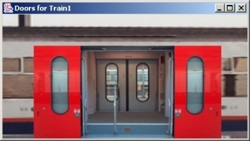
Prototypes & mock-ups
Goal: check req adequacy from direct user feedback, by showing reduced sketch of software-to-be in action
  focus on unclear, hard-to-formulate reqs to elicit further
Prototype = quick implementation of some aspects ...
  Functional proto: focus on specific functional reqs
    e.g. initiating meeting, gathering participant constraints
  User interface proto: focus on usability by showing input-output forms, dialog patterns
    e.g. static/dynamic interaction to get participant constraints
Quick implementation: by use of very high-level programming language, executable spec language, generic services, ...

Slide 20

Requirements prototyping
Elaborate
requirements
Prototype
requirements
Demonstrate proto
& get feedback
[ not Proto_OK ]
[ Proto_OK ]
…
Mock-up: proto is thrown away (product = adequate reqs)
Evolutionary proto: transformed towards efficient code

Slide 21
Prototypes & mock-ups: pros & cons
☺ Concrete flavor of what the software will look like
=> clarify reqs, elicit hidden ones, improve adequacy,
understand implications, ...
☺ Other uses: user training, stub for integration testing, ...
☹ Does not cover all aspects
  missing functionalities
  ignores important non-functional reqs (performance, cost, ...)
☹ Can be misleading, set expectations too high
☹ ‘Quick-and-dirty’ code, hard to reuse for sw development
☹ Potential inconsistencies between modified code and documented reqs

Slide 22

Knowledge reuse
Goal: speed up elicitation by reuse of knowledge from experience with related systems
  knowledge about similar organization, domain, problem world: requirements, assumptions, dom props, ...
General reuse process:
  1. RETRIEVE relevant knowledge from other systems
  2. TRANSPOSE it to the target system
  3. VALIDATE the result, ADAPT it if necessary & INTEGRATE it with the system knowledge already acquired
Transposition mechanisms:
  instantiation (memberOf)
  specialization (subClassOf) + feature inheritance
  reformulation in vocabulary of target system

Slide 23
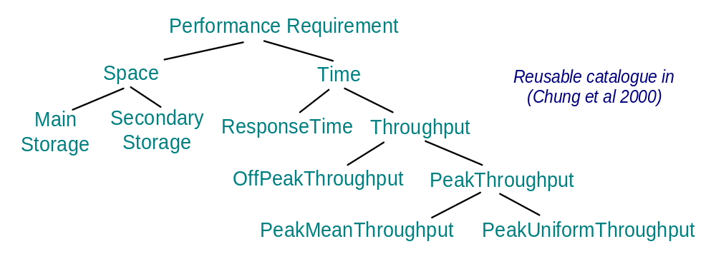
Reuse of domain-independent knowledge: requirements taxonomies
For each leaf node in available req taxonomies:
“Is there any system-specific req instance from this class?”
More specific taxonomy => more focussed search
response time for ...
participant constraints ?
meeting scheduling ?
meeting notification ?
mean number of meetings to
be scheduled at peak times ?

Slide 24
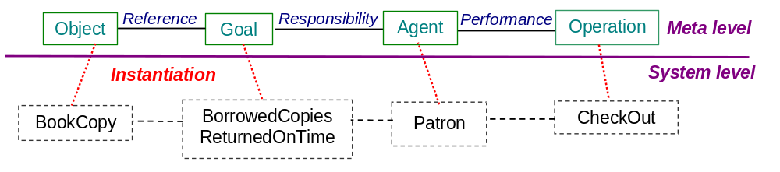
Reuse of domain-independent knowledge:
RD meta-model
RD meta-model = concepts & relationships in terms of which RD items are captured
Elicitation by meta-model traversal
RD items are acquired as instantiations of meta-model items

Slide 25
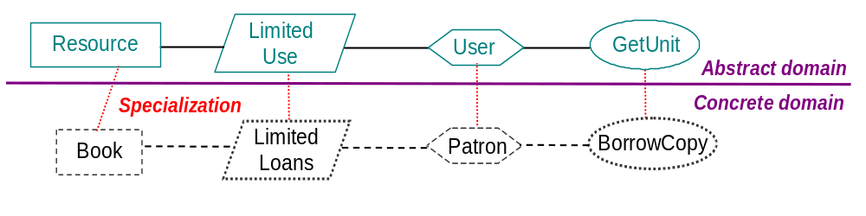
Reuse of domain-specific knowledge
Abstract domain = concepts, tasks, actors, objectives, reqs, dom props abstracting from a class of domains
RD items acquired as specializations of abstract items to target system (feature inheritance + system-specific renaming)
Spec inheritance
“A user may not use more than X resource units at a time”
“A patron may not borrow more than X book copies at a time”

Slide 26
Reuse of domain-specific knowledge (2)
Same abstract domain may have multiple specializations
  e.g. resource management <-- library loan management,
  video store management, flight or concert seat allocation, ...
Same concrete domain may specialize multiple abstract domains
  e.g. library management:
  loan management --> resource management
  book acquisition --> e-shopping
  patron registration --> group membership management
More adequate RD items elicited by reuse of more structured, more accurate abstract domains
  e.g. resource management: returnable vs. consumable resource
    sharable vs. non-sharable resource
    => “A book copy can be borrowed by one patron at a time”
    (dom prop for non-sharable, returnable resource)

Slide 27
Knowledge reuse: pros & cons
☺ Expert analysts naturally reuse from past experience
☺ Significant guidance and reduction of elicitation efforts
☺ Inheritance of structure & quality of abstract domain spec
☺ Effective for completing RD with overlooked aspects
☹ Effective only if abstract domain sufficiently “close”, accurate
☹ Defining abstract domains for significant reusability is hard
☹ Validation & integration efforts
☹ Near-matches may require tricky adaptations

Slide 28
Domain analysis & requirements elicitation: outline
Identifying stakeholders & interacting with them
Artifact-driven elicitation techniques
  Background study
  Data collection, questionnaires
  Repertory grids, card sorts for concept acquisition
  Scenarios, storyboards for problem world exploration
  Prototypes, mock-ups for early feedback
  Knowledge reuse: domain-independent, domain-specific
Stakeholder-driven elicitation techniques
  Interviews
  Observation and ethnographic studies
  Group sessions

Slide 29

Interviews
Primary technique for knowledge elicitation
  1. Select stakeholder specifically for info to be acquired
  (domain expert, manager, salesperson, end-user, consultant, ...)
  2. Organize meeting with interviewee, ask questions, record answers
  3. Write report from interview transcripts
  4. Submit report to interviewee for validation & refinement
Single interview may involve multiple stakeholders
  ☺ saves times
  ☹ weaker contact; individuals less involved, speak less freely
Interview effectiveness:
  (utility x coverage of acquired info) / acquisition time

Slide 30
Types of interview
Structured interview: predetermined set of questions
  specific to purpose of interview
  some open-ended, others with pre-determined answer set
  => more focused discussion, no rambling among topics
Unstructured interview: no predetermined set of questions
  free discussion about system-as-is, perceived problems, proposed solutions
  => exploration of possibly overlooked issues
=> Effective interviews should mix both modes ...
  start with structured parts
  shift to unstructured parts as felt necessary

Slide 31
Interviews: strengths & difficulties
☺ May reveal info not acquired through other techniques
  how things are running really, personal complaints, suggestions for improvement, ...
☺ On-the-fly acquisition of info appearing relevant
  new questions triggered from previous answers
☹ Acquired info might be subjective (hard to assess)
☹ Potential inconsistencies between different interviewees
☹ Effectiveness critically relies on interviewer’s attitude, appropriateness of questions
=> Interviewing guidelines

Slide 32
Guidelines for effective interviews
Identify the right interviewee sample for full coverage of issues
  different responsibilities, expertise, tasks, exposure to problems
Come prepared, to focus on right issue at right time
  background study first
  pre-design a sequence of questions for this interviewee
Centre the interview on the interviewee’s work & concerns
Keep control over the interview
Make the interviewee feel comfortable
  Start: break ice, provide motivation, ask easy questions
  Consider the person too, not only the role
  Do always appear as a trustworthy partner

Slide 33
Guidelines for effective interviews (2)
Be focused, keep open-ended questions for the end
Be open-minded, flexible in case of unexpected answers
Ask why-questions without being offending
Avoid certain types of questions ...
  opinionated or biased
  affirmative
  obvious or impossible answer for this interviewee
Edit & structure interview transcripts while still fresh in mind
  including personal reactions, attitudes, etc
Keep interviewee in the loop
  co-review interview transcript for validation & refinement
Model-driven interviews may help structure them
(see Part 2 of the book)

Slide 34

Observation & ethnographic studies
Focus on task elicitation in the system-as-is
Understanding a task is often easier by observing people performing it (rather than verbal or textual explanation)
  cf. tying shoelaces
Passive observation: no interference with task performers
  Watch from outside, record (notes, video), edit transcripts, interpret
  Protocol analysis: task performers concurrently explain it
  Ethnographic studies: over long periods of time, try to discover emergent properties of social group involved
    about task performance + attitudes, reactions, gestures, ...
Active observation: you get involved in the task, even become a team member

Slide 35
Observation & ethnographic studies: pros & cons
☺ May reveal ...
  tacit knowledge that would not emerge otherwise
  e.g. ethnographic study of air traffic control => implicit mental
  model of air traffic to be preserved in system-to-be
  hidden problems through tricky ways of doing things
  culture-specific aspects to be taken into account
☺ Contextualization of acquired info
☹ Slow & expensive: to be done over long periods of time,
at different times, under different workload conditions
☹ Potentially inaccurate (people behave differently when observed)
☹ Data mining problem, interpretation problem
☹ Focus on system-as-is
Some of the interviewing guidelines are relevant

Slide 36

Group sessions
More perception, judgment, invention from interactions within group of diverse people
Elicitation takes place in series of group workshops (a few days each) + follow-up actions
  audiovisuals, wall charts to foster discussion, record outcome
Structured group sessions:
  Each participant has a clearly defined role
  (leader, moderator, manager, user, developer, ...)
  Contributes to req elaboration according to his/her role, towards reaching synergies
  Generally focused on high-level reqs
  Variants: focus groups, JAD, QFD, ...

Slide 37
Group sessions (2)
Unstructured group sessions (brainstorming):
  Participants have a less clearly defined role
  Two separate stages ...
    1. Idea generation to address a problem:
    as many ideas as possible
    from each participant
    without censorship/criticism
    2. Idea evaluation:
    by all participants together
    according to agreed criteria (e.g. value, cost, feasibility)
    to prioritize ideas

Slide 38
Group sessions: pros & cons
☺ Less formal interactions than interviews
=> may reveal hidden aspects of the system (as-is or to-be)
☺ Potentially ...
  wider exploration of issues & ideas
  more inventive ways of addressing problems
☺ Synergies => agreed conflict resolutions
☹ Group composition is critical ...
  time consuming for key, busy people
  heavily relying on leader expertise & skills
  group dynamics, dominant persons => biases, inadequacies
☹ Risk of ...
  missing focus & structure => rambling discussions, little concrete outcome, waste of time
  superficial coverage of more technical issues

Slide 39
Combining techniques
Elicitation techniques have complementary strengths & limitations
Strength-based combinations are more effective for full, adequate coverage
  artefact-driven + stakeholder-driven
Examples
  Contextual Inquiry: workplace observation + open-ended interviews + prototyping
  RAD: JAD group sessions + evolutionary prototyping (with code generation tools)
Techniques from other RE phases support elicitation too
  Resolution of conflicts, risks, omissions, etc.

Slide 40
Domain analysis & requirements elicitation: summary
Identifying the right stakeholders, interacting the right way
Artifact-driven elicitation techniques
  Background study as a prerequisite
  Data collection, questionnaires for preparing interviews
  Repertory grids, card sorts for concept characterization
  Scenarios, storyboards for concrete exploration
  Prototypes, mock-ups for early feedback & adequacy check
  Knowledge reuse brings a lot: domain-independent, domain-specific
Stakeholder-driven elicitation techniques
  Interviews are essential - structured, unstructured, cf. guidelines
  Observation, ethnographic studies for hidden knowledge
  Group sessions for broader, more inventive acquisition & agreement
Model-driven elicitation provides focus & structure for what needs to be elicited (see Part 2 of the book)

Slide 41
Domain analysis & requirements elicitation: outline
Identifying stakeholders & interacting with them
Artifact-driven elicitation techniques
  Background study
  Data collection, questionnaires
  Repertory grids, card sorts for concept acquisition
  Scenarios, storyboards for problem world exploration
  Prototypes, mock-ups for early feedback
  Knowledge reuse: domain-independent, domain-specific
Stakeholder-driven elicitation techniques
  Interviews
  Observation and ethnographic studies
  Group sessions

Slide 42
Interviews
Primary technique for knowledge elicitation
  1. Select stakeholder specifically for info to be acquired
  (domain expert, manager, salesperson, end-user, consultant, ...)
  2. Organize meeting with interviewee, ask questions, record answers
  3. Write report from interview transcripts
  4. Submit report to interviewee for validation & refinement
Single interview may involve multiple stakeholders
  ☺ saves times
  ☹ weaker contact; individuals less involved, speak less freely
Interview effectiveness:
  (utility x coverage of acquired info) / acquisition time

Slide 43
Types of interviews
Structured interview: predetermined set of questions
  specific to purpose of interview
  some open-ended, others with pre-determined answer set
  => more focused discussion, no rambling among topics
Unstructured interview: no predetermined set of questions
  free discussion about system-as-is, perceived problems, proposed solutions
  => exploration of possibly overlooked issues
=> Effective interviews should mix both modes ...
  start with structured parts
  shift to unstructured parts as felt necessary

Slide 44
Interviews: strengths & difficulties
☺ May reveal info not acquired through other techniques
  how things are running really, personal complaints, suggestions for improvement, ...
☺ On-the-fly acquisition of info appearing relevant
  new questions triggered from previous answers
☹ Acquired info might be subjective (hard to assess)
☹ Potential inconsistencies between different interviewees
☹ Effectiveness critically relies on interviewer’s attitude, appropriateness of questions
=> Interviewing guidelines

Slide 45
Guidelines for effective interviews
Identify the right interviewee sample for full coverage of issues
  different responsibilities, expertise, tasks, exposure to problems
Come prepared, to focus on right issue at right time
  background study first
  pre-design a sequence of questions for this interviewee
Centre the interview on the interviewee’s work & concerns
Keep control over the interview
Make the interviewee feel comfortable
  Start: break ice, provide motivation, ask easy questions
  Consider the person too, not only the role
  Do always appear as a trustworthy partner

Slide 46
Guidelines for effective interviews (2)
Be focused, keep open-ended questions for the end
Be open-minded, flexible in case of unexpected answers
Ask why-questions without being offending
Avoid certain types of questions ...
  opinionated or biased
  affirmative
  obvious or impossible answer for this interviewee
Edit & structure interview transcripts while still fresh in mind
  including personal reactions, attitudes, etc
Keep interviewee in the loop
  co-review interview transcript for validation & refinement
Model-driven interviews may help structure them
(see Part 2 of the book)

Slide 47
Observation & ethnographic studies
Focus on task elicitation in the system-as-is
Understanding a task is often easier by observing people performing it (rather than verbal or textual explanation)
  cf. tying shoelaces
Passive observation: no interference with task performers
  Watch from outside, record (notes, video), edit transcripts, interpret
  Protocol analysis: task performers concurrently explain it
  Ethnographic studies: over long periods of time, try to discover emergent properties of social group involved
    about task performance + attitudes, reactions, gestures, ...
Active observation: you get involved in the task, even become a team member

Slide 48
Observation & ethnographic studies: pros & cons
☺ May reveal ...
  tacit knowledge that would not emerge otherwise
  e.g. ethnographic study of air traffic control => implicit mental
  model of air traffic to be preserved in system-to-be
  hidden problems through tricky ways of doing things
  culture-specific aspects to be taken into account
☺ Contextualization of acquired info
☹ Slow & expensive: to be done over long periods of time,
at different times, under different workload conditions
☹ Potentially inaccurate (people behave differently when observed)
☹ Data mining problem, interpretation problem
☹ Focus on system-as-is
Some of the interviewing guidelines are relevant

Slide 49
Group sessions
More perception, judgment, invention from interactions within group of diverse people
Elicitation takes place in series of group workshops (a few days each) + follow-up actions
  audiovisuals, wall charts to foster discussion, record outcome
Structured group sessions:
  Each participant has a clearly defined role
  (leader, moderator, manager, user, developer, ...)
  Contributes to req elaboration according to his/her role, towards reaching synergies
  Generally focused on high-level reqs
  Variants: focus groups, JAD, QFD, ...

Slide 50
Group sessions (2)
Unstructured group sessions (brainstorming):
  Participants have a less clearly defined role
  Two separate stages ...
    1. Idea generation to address a problem:
    as many ideas as possible
    from each participant
    without censorship/criticism
    2. Idea evaluation:
    by all participants together
    according to agreed criteria (e.g. value, cost, feasibility)
    to prioritize ideas

Slide 51
Group sessions: pros & cons
☺ Less formal interactions than interviews
=> may reveal hidden aspects of the system (as-is or to-be)
☺ Potentially ...
  wider exploration of issues & ideas
  more inventive ways of addressing problems
☺ Synergies => agreed conflict resolutions
☹ Group composition is critical ...
  time consuming for key, busy people
  heavily relying on leader expertise & skills
  group dynamics, dominant persons => biases, inadequacies
☹ Risk of ...
  missing focus & structure => rambling discussions, little concrete outcome, waste of time
  superficial coverage of more technical issues

Slide 52
Combining techniques
Elicitation techniques have complementary strengths & limitations
Strength-based combinations are more effective for full, adequate coverage
  artifact-driven + stakeholder-driven
Examples
  Contextual Inquiry: workplace observation + open-ended interviews + prototyping
  RAD: JAD group sessions + evolutionary prototyping (with code generation tools)
Techniques from other RE phases support elicitation too
  Resolution of conflicts, risks, omissions, etc.

Slide 53
Domain analysis & requirements elicitation: summary
Identifying the right stakeholders, interacting the right way
Artifact-driven elicitation techniques
  Background study as a prerequisite
  Data collection, questionnaires for preparing interviews
  Repertory grids, card sorts for concept characterization
  Scenarios, storyboards for concrete exploration
  Prototypes, mock-ups for early feedback & adequacy check
  Knowledge reuse brings a lot: domain-independent, domain-specific
Stakeholder-driven elicitation techniques
  Interviews are essential - structured, unstructured, cf. guidelines
  Observation, ethnographic studies for hidden knowledge
  Group sessions for broader, more inventive acquisition & agreement
Model-driven elicitation provides focus & structure for what needs to be elicited (see Part 2 of the book)

